Slide 1
聲學傳遞函數盲估計以應用於去混響、聲源分離以及增強 Blind estimation of acoustic transfer functions with application to signal dereverberation, source separation, and speech enhancement Date：2024. 07. 24
Telecom Electroacoustics Audio(TEA) Lab
Presenter: 袁安志
Research supervisor : 白明憲
Notes:
Hello everyone
I’m today’s presenter siang. I’m going to share some of my present work in source separation problem. My topic is comparative studies of source separation using semi-blind and blind source separation approaches.

Slide 2
Outline
Chapter 1 Introduction
Chapter 2 Baseline approach
Chapter 3 Signal model
Chapter 4 Proposed method
Chapter 5 Simulations
Chapter 6 Experiments
Chapter 7 Conclusions and Future work
References

Slide 3
Chapter 1 Introduction
Motivation
Literature review

Slide 4

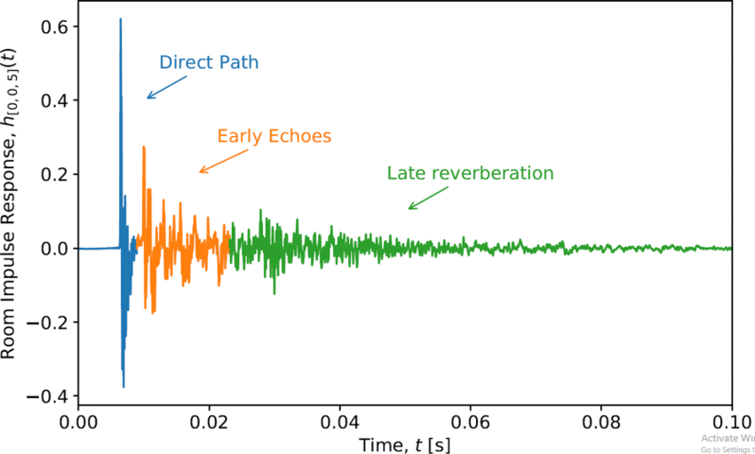


Motivation
Acoustic transfer functions (ATFs) v.s. Relative transfer functions (RTFs)
Unavailability of the source signal
Most blind system identification (BSI) → multiplication transfer function (MTF)
Proposed method → convolutive transfer function (CTF)
ATF
RTF
Magnitude
Time samples

Slide 5
Literature review
Subspace (SS) algorithm
[3]
Higher-order statistics
[1]
Second-order statistics (SOS)
[2]
Cross relation (CR) algorithm
[4]
Slow convergence
local minimum
Blind system identification (BSI)
Computatioally intensive
Difficult in adaptive mode
Time domain adaptive eigenvalue decomposition
algorithm (TAEDA)
[5]
Frequency domain adaptive eigenvalue decomposition
algorithm (FAEDA)
[6]
Short RIR

Slide 6
Chapter 2 Baseline approach

Slide 7
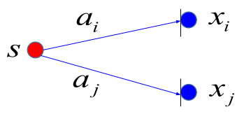
Baseline approach (state-of-the-art BSI method)

Slide 8
Chapter 3 Signal model

Slide 9
Signal model
s(n)
y(n)
a(n)

Slide 10
Chapter 4 Proposed method
Flow chart
Pre-processing
Wiener filter approach
RLS approach
Kalman approach
ATF reconstruction
Parameters optimization

Slide 11

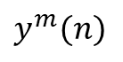
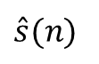
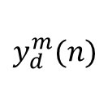
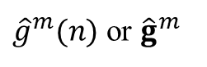

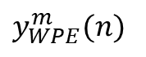
Flow chart of proposed method
$$y_{d}^{m}(n)$$
Signal
delay
Parameters optimization
$\hat{A}$
Weighted
prediction
error (WPE)
Three CTF coefficients estimated approach
ATF reconstruction
MINT dereverberation
DAS
beamformer
$y^{m}(n)$
s_{DAS,p}
$\hat{A}$
${\hat{g}}^{m}(n)$ or ${\hat{g}}^{m}$
$\hat{s}(n)$
$y_{WPE}^{m}(n)$

Slide 12
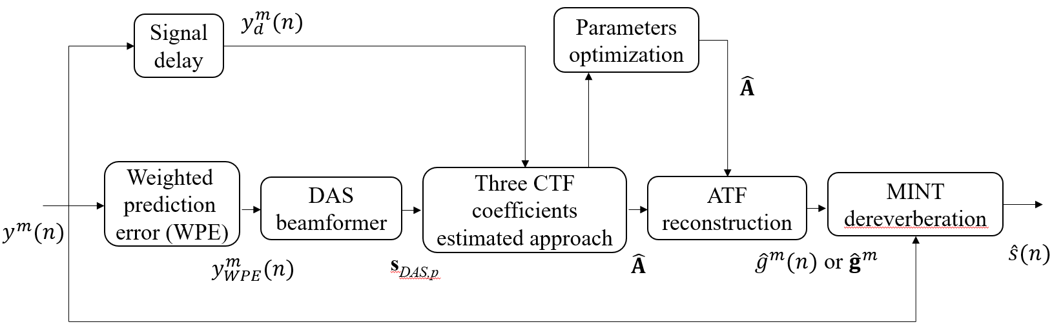
Outline of the proposed method
Parameters optimization
Pre-processing
MINT dereverberation
ATF reconstruction
Wiener filter approach
RLS approach
Kalman filter approach

Slide 13
Pre-processing of the proposed method
Extraction of source signal
WPE for dereverberation
DAS beamformer for cleaner source

Slide 14
WPE for dereverberation
Signal formation
Algorithm for WPE

Slide 15
Signal formation
Time samples
C

Slide 16
Signal formation

Slide 17
Algorithm for WPE

Slide 18
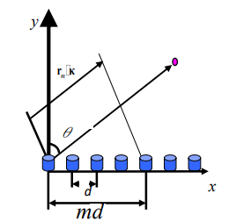
DAS beamformer for cleaner source
R^{m}

Slide 19
Proposed methods for ATF estimation
Three CTF coefficients estimated approaches
Wiener filter approach
RLS approach
Kalman filter approach

Slide 20
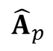
Wiener filter approach
y_{d,p}
s_{DAS,p}
R_{ss,p}
R_{sy,p}
${\hat{A}}_{p}$
Recursive average
Wiener filtering

Slide 21
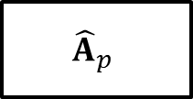
RLS approach
s_{DAS,p}
-
y_{d,p}
₊
$${\hat{A}}_{p}$$
∑
e_{p}

Slide 22
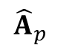
Kalman filter approach
y_{d,p}
s_{DAS,p}
Measurement update
(correction)
$${\hat{A}}_{p}$$
P_{Kalman,p}
No time update (prediction)

Slide 23
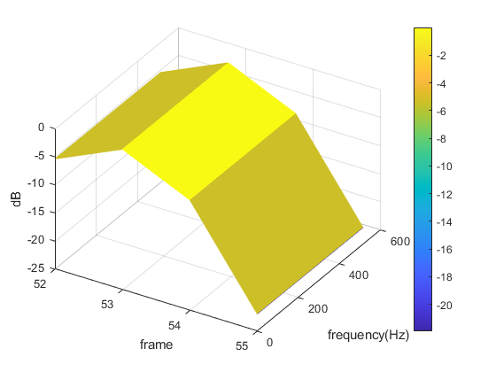
ATF reconstruction
δ_{p}
(k)

Slide 24
Parameters optimization
Particle swarm optimization (PSO)
Concept for PSO
Flowchart for PSO
Equations for PSO
A novel hybrid PSO algorithm using an adaptive strategy (ASPSO)
Flowchart for PSO
Equations for PSO

Slide 25
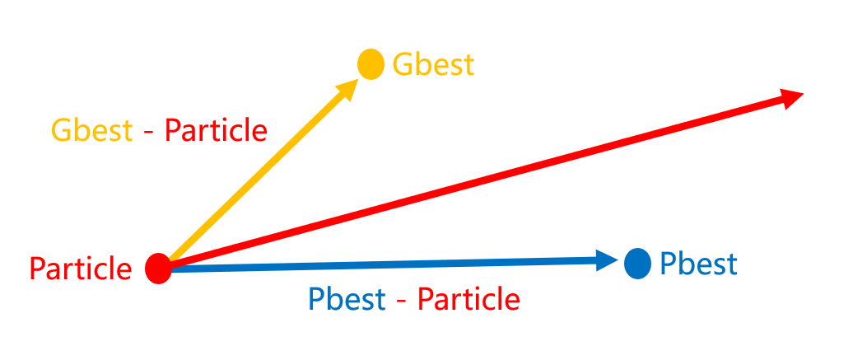
Concept for PSO
Optimization variable → Initial parameters in three CTF coefficients estimation approaches
Personal best location & Global best location
Global exploration ←→ Local exploitation

Slide 26
Flowchart for PSO
Randomly initialize particle locations X and velocities V
Calculate fitness of particle
Update pbest gbest
Stopping criteia met?
Output gbest
Yes
No
Update particle velocities and locations

Slide 27
Equations for PSO

Slide 28
Kalman filter approach
y_{d,p}
s_{DAS,p}
Measurement update
(correction)
$${\hat{A}}_{p}$$
P_{Kalman,p}
No time update (prediction)

Slide 29
Flowchart for ASPSO
Output gbest
Randomly initialize particle locations X and velocities V
Yes
No
Stopping criteia met?
4. Competitive substitution mechanism
Calculate fitness of particle
Update gbest
Update pbest gbest
1. Inertia weight with chaotic
Update pbest
Update inertia weight w_{in}
Replace the particle with the worst fitness
Select Cpbest
Calculate Fpbest
Calculate Mpbest
Update particle position
2. Elite and dimensional learning strategies
Update particle position using spiral-shaped mechanism
Update particle velocity
Yes
3. Adaptive position update strategy
β < rand?
No

Slide 30
Equations for ASPSO
1. Inertia weight with chaotic
2. Elite and dimensional learning strategies

Slide 31
Equations for ASPSO
3. Adaptive position update strategy
4. Competitive substitution mechanism

Slide 32
Chapter 5 Simulations
Fixed Source Location Cases
Fixed Source Location with Parameters Optimization
Applications of Estimated ATFs and RIRs
Moving Source Location Cases

Slide 33
MINT dereverberation
Schematic diagram for MINT
Algorithm for MINT

Slide 34
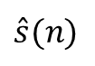
Schematic diagram for MINT
ATF in a room
Inverse filter weight
a¹(z)
y¹(n)
w¹(z)
a²(z)
y²(n)
w²(z)
$\hat{s}(n)$
s(n)
.
.
.
.
.
.
a^{M}(z)
y^{M}(n)
w^{M}(z)

Slide 35
Algorithm for MINT

Slide 36
Simulations
Proposed method v.s. State-of-the-art BSI (short RIR)
Without Parameters Optimization (long RIR)
With Parameters Optimization (long RIR)
short RIR
long RIR

Slide 37
Simulations
Proposed method v.s. State-of-the-art BSI (short RIR)
Without Parameters Optimization (long RIR)
With Parameters Optimization (long RIR)

Slide 38
Proposed method v.s. State-of-the-art BSI (short RIR)
Parameters and settings
RIR estimation results

Slide 39
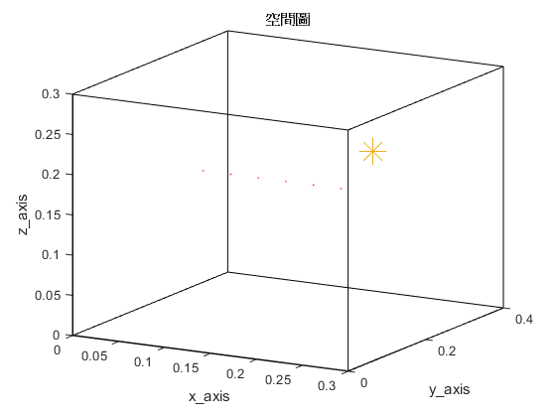
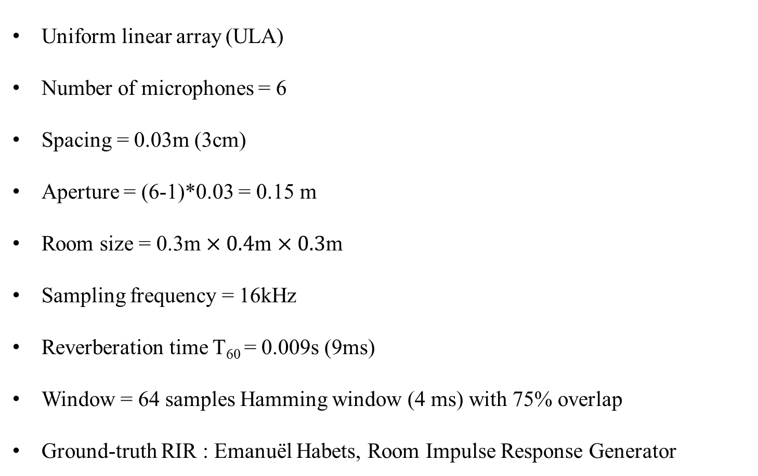
Parameters and settings
Small room
Uniform linear array (ULA)
Number of microphones = 6
Spacing = 0.03m (3cm)
Aperture = (6-1)*0.03 = 0.15 m
Room size = 0.3m $×0.4$m $×0.3$m
Sampling frequency = 16kHz
Reverberation time T₆₀ = 0.009s (9ms)
Window = 64 samples Hamming window (4 ms) with 75% overlap
Ground-truth RIR : Emanuël Habets, Room Impulse Response Generator
MIC
Source
H = 0.3m
W = 0.3m
L = 0.4m

Slide 40
RIR estimation results
Absolute error
Absolute error
Frequency (Hz)
Frequency (Hz)
RIR
RIR
Time samples
Time samples
Baseline approach
Wiener filter approach

Slide 41
RIR estimation results
Absolute error
Absolute error
Frequency (Hz)
Frequency (Hz)
RIR
RIR
Time samples
Time samples
RLS
Kalman filter
 | Baseline | Wiener filter | RLS | Kalman filter
ME | 7.33 | 2.65 | 4.90 | 2.17

Slide 42
Simulations
Compare with state-of-the-art BSI method (short RIR)
Without Parameters Optimization (long RIR)
With Parameters Optimization (long RIR)

Slide 43
Without Parameters Optimization (long RIR)
Parameters and settings
RIR estimation results
MINT dereverberation results

Slide 44
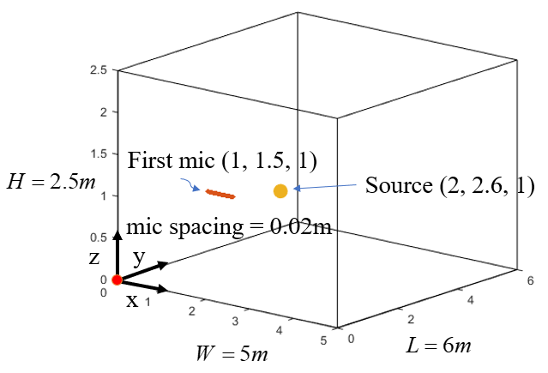
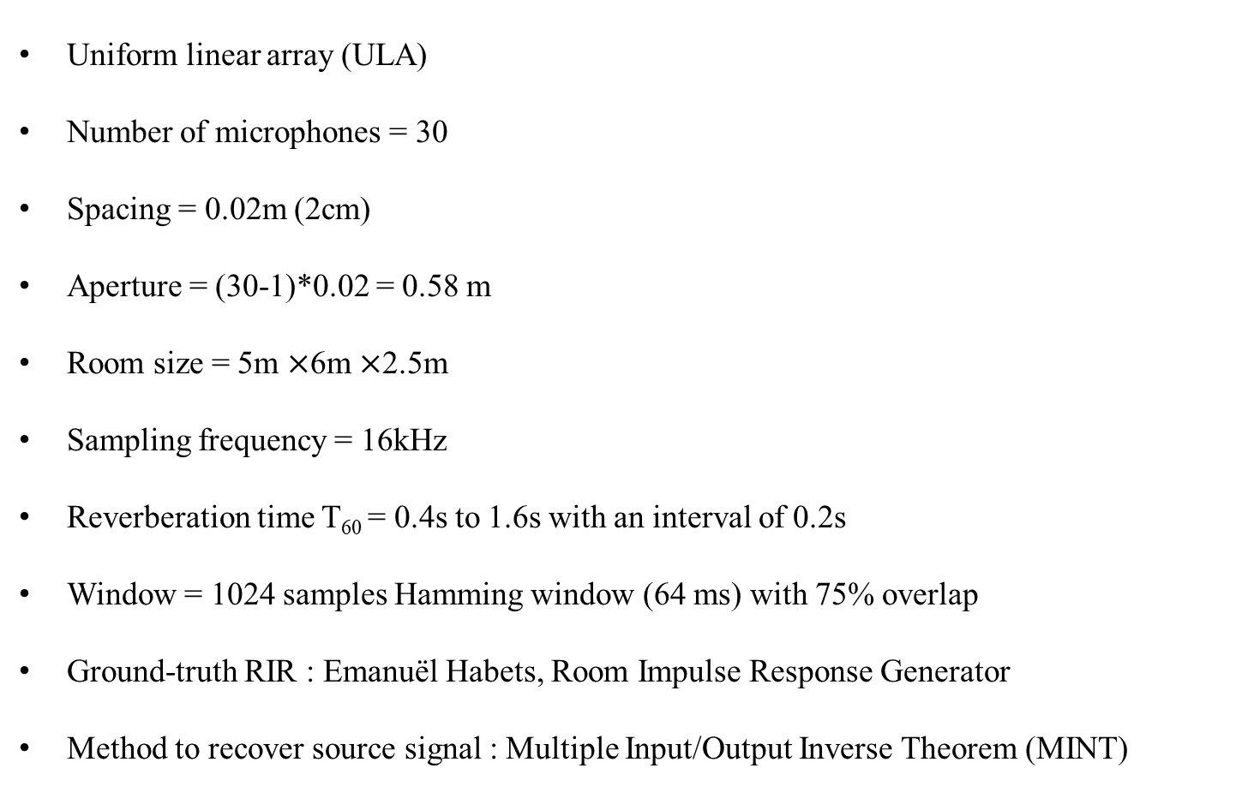
Parameters and settings
Big room
Uniform linear array (ULA)
Number of microphones = 30
Spacing = 0.02m (2cm)
Aperture = (30-1)*0.02 = 0.58 m
Room size = 5m $×$6m $×$2.5m
Sampling frequency = 16kHz
Reverberation time T₆₀ = 0.4s to 1.6s with an interval of 0.2s
Window = 1024 samples Hamming window (64 ms) with 75% overlap
Ground-truth RIR : Emanuël Habets, Room Impulse Response Generator
Method to recover source signal : Multiple Input/Output Inverse Theorem (MINT)

Slide 45
RIR estimation results
forgetting factor α in Wiener filter | forgetting factor λ in RLS | ε in RLS | η in Kalman filter | ρ in Kalman filter
0.999 | 0.99 | 0.01 | 0.5 | 0.001
Absolute error
Frequency (Hz)
RIR
Time samples
Wiener filter with T₆₀ = 0.6s

Slide 46
RIR estimation results
Absolute error
Absolute error
Frequency (Hz)
Frequency (Hz)
RIR
RIR
Time samples
Time samples
RLS with T₆₀ = 0.6s
Kalman filter with T₆₀ = 0.6s

Slide 47
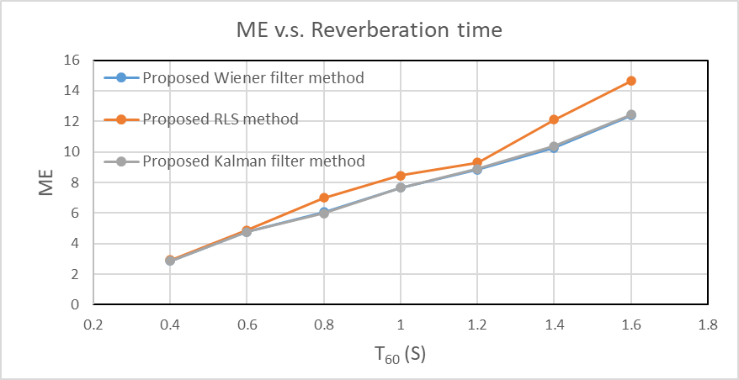
RIR estimation results
T₆₀ (s) method | 0.4 | 0.6 | 0.8 | 1 | 1.2 | 1.4 | 1.6
Wiener filter | 2.86 | 4.76 | 6.05 | 7.66 | 8.83 | 10.26 | 12.37
RLS | 2.91 | 4.87 | 6.98 | 8.46 | 9.30 | 12.12 | 14.63
Kalman filter | 2.86 | 4.76 | 5.97 | 7.64 | 8.90 | 10.37 | 12.43

Slide 48
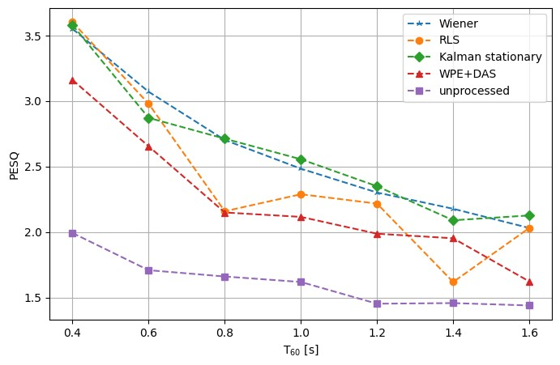
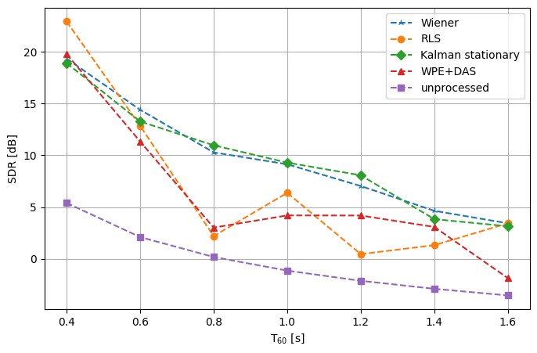
MINT dereverberation results
Perceptual Evaluation of Speech Quality (PESQ)
range: [-0.5 4.5]
SDR (dB)
PESQ

Slide 49

MINT dereverberation results
 | Ground-truth source | Microphone received | WPE+DAS | Wiener filter (MINT) | RLS (MINT) | Kalman filter (MINT)
T₆₀ = 0.6s
T₆₀ = 0.8s
T₆₀ = 1.0s

Slide 50
Simulations
Compare with state-of-the-art BSI method (short RIR)
Without Parameters Optimization (long RIR)
With Parameters Optimization (long RIR)

Slide 51
With Parameters Optimization
Here, we take η and ρ in Kalman filter as the parameters needed to be optimized.
Method | ME
Kalman filter without parameters optimization | 5.07
Kalman filter with PSO | 4.97
Kalman filter with ASPSO | 4.94

Slide 52
Chapter 6 Experiments
Settings and Parameters
Results and Discussions

Slide 53
Chapter 7 Conclusions and future work

Slide 54
Conclusions
Proposed three approaches
Accurate ATF estimation
low matching error
In short reverberation time scenarios
Proposed method outperform baseline BSI method
In long reverberation time scenarios
baseline BSI method → failure
Proposed method outperform WPE following DAS beamformer
Parameters optimization
Lower matching error

Slide 55
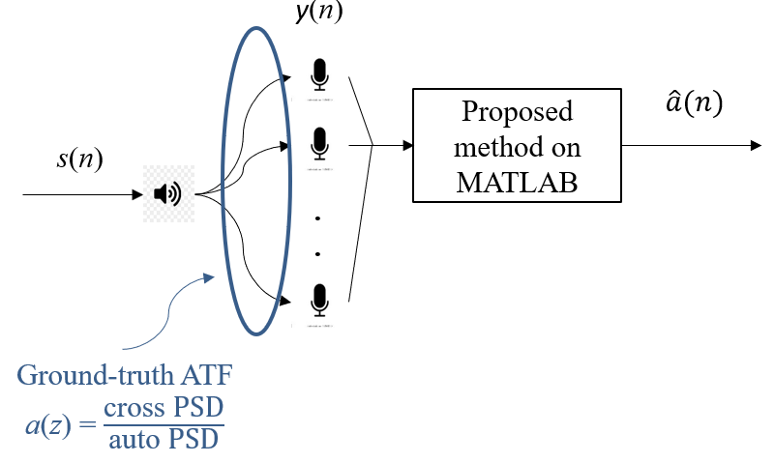
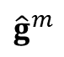
Future work
Moving sources → Process noise in Kalman non-stationary filter
Real experiments
State-of-the-art BSI → CTF signal model
$${\hat{g}}^{m}$$
g^{m}

Slide 56
References
Y. Sato , “ A method of self-recovering equalization for multilevel amplitude-modulaion IEEE Trans. Commu, vol. 23, no. 6, pp. 679-682, 1975.
L. Tong, G. Xu, and T. Kailath, “A new approach to blind identification and equalization of multipath channels,” Proc. 25th Asilomar Conf. Signals, Syst., Comput, vol. 2, pp. 856–860, 1991.
E. Moulines, P. Duhamel, J. F. Cardoso, and S. Mayrargue, “Subspace methods for the blind identification of multichannel FIR filters,” IEEE Trans. Signal Processing, vol. 43, pp. 516–525, Feb. 1995.
H. Liu, G. Xu, and L. Tong, “A deterministic approach to blind equalization,” Proc. 27th Asilomar Conf. Signals, Syst., Comput, vol. 1, pp. 751–755, 1993.
Y. Huang and J. Benesty, “Adaptive multi-channel least mean square and Newton algorithms for blind channel identification,” Signal Processing, vol. 82, no. 8, pp. 1127–1138, Aug. 2002.
M. A. Haque and M. K. Hasan, “Noise robust multichannel frequency-domain LMS algorithms for blind channel identification,” IEEE Signal Processing Letters, vol. 15, pp. 305–308, 2008.
T. Nakatani, T. Yoshioka, K. Kinoshita, M. Miyoshi and B. -H. Juang, “Speech Dereverberation Based on Variance-Normalized Delayed Linear Prediction,” IEEE Trans. Audio, Speech, Lang. Process., vol. 18, no. 7, pp. 1717–1731, 2010.
Rui ang, Kuangrong Hao, Lei Chen, Tong Wang, and Chunli Jiang, “A novel hybrid particle swarm optimization using adaptive strategy,” Information Sciences, vol. 579, pp. 231-250, 2021.
S. A. U. Islam and D. S. Bernstein, “Recursive Least Squares for Real-Time Implementation,” IEEE Control Systems Magazine, vol. 39, no. 3, pp. 82-85, June 2019.

Slide 57


© anchi_0203

